Slide 1
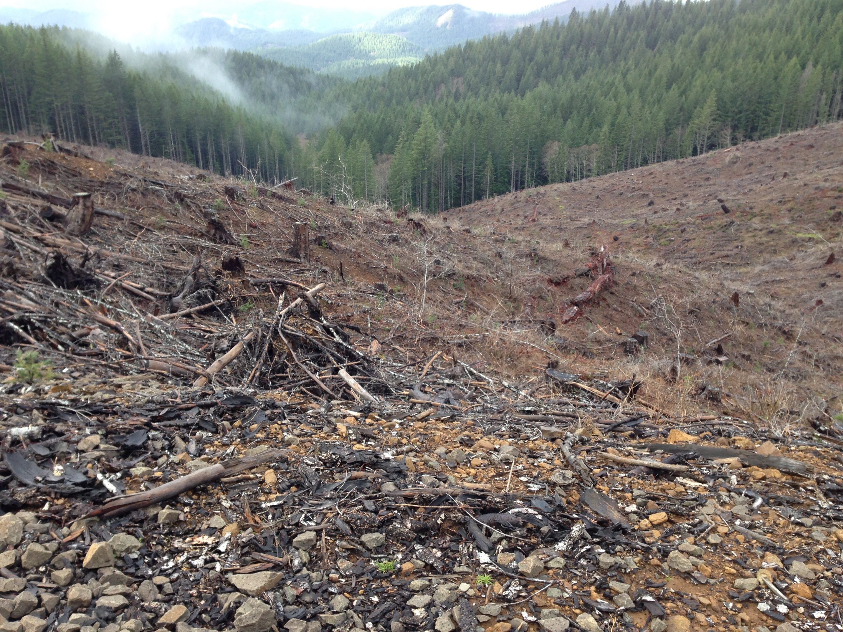
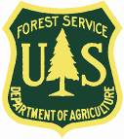
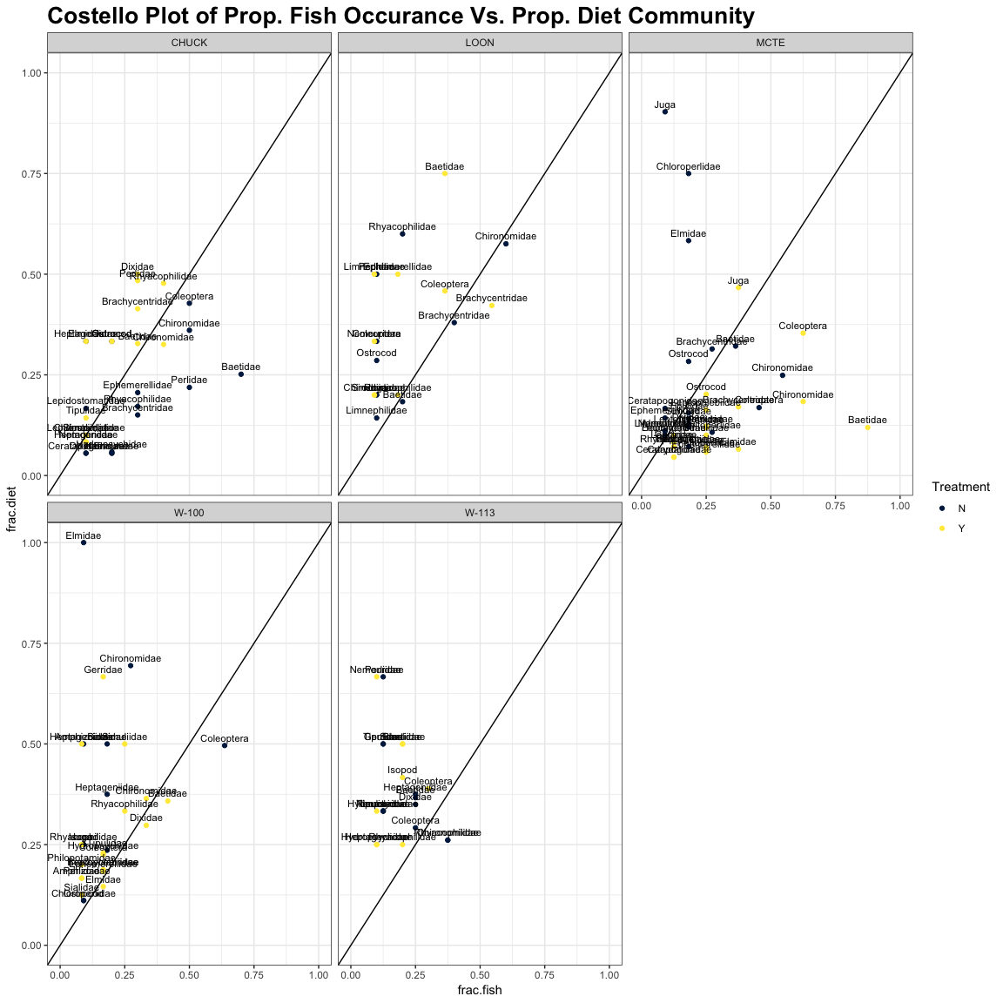
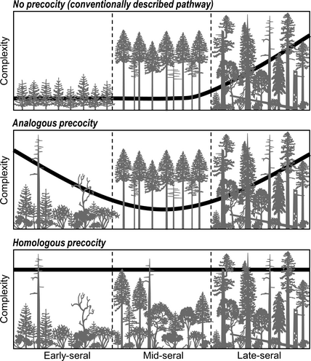
Effects of Light on Fish Diets and Macroinvertebrate
Community Assemblage
Cedar Mackaness^{1*}, Allison Swartz, & Dana R. Warren^{1,2}
¹Department of Fisheries and Wildlife - Oregon State University 2, Department of Forests Ecosystems and Society - Oregon State University
*corresponding author: mackanec@oregonstate.edu
Background
Riparian forests in the PNW have been heavily harvested, leaving dense, second growth vegetation that shades out streams. As these forests undergo stand development, tree mortality and natural disturbances will increase canopy heterogeneity and light availability.
Figure 1. Cartoon illustrating second growth forests have closed canopies, whereas old-growth and mature stands have canopy gaps allowing light to reach the stream benthos.
Under current conditions we would expect: dense canopies → light limited GPP → low abundance of herbivorous invertebrates.
Results
Results
Results
Conclusions
Study Questions
Given current light conditions, will a canopy gap affect the macroinvertebrate community?
Canopy opening manipulations will result in increases in herbivorous invertebrates which will be reflected in fish diets.
Methods
Sampled 5 reach pairs over 2 years. A canopy gap (~40 m. diameter) was cut in the treatment reach in between sampling years.
Benthic samples were taken with a Surber Sampler and diets were collected via gastrolavage.
Benthic samples were ID’ed to LTU, diets were ID’ed to the family level.
Analyses were performed in R using the Vegan package
Study location:
Acknowledgements:
References:

